Slide 1
CUSTOMER PREDICTION

Slide 2
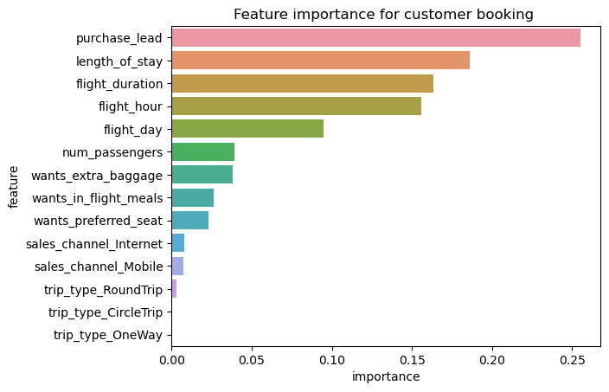
Features that contributed to the model
Evaluation metrics
Accuracy: 0.63
Recall:0.63
Precision:0.629
The most important variable in the model was purchase_lead,
that is the time between purchase and departure
Length of stay also plays a key role in determining if a customer will
Complete the booking

